Slide 1
Error changes with variance of points amount

Slide 2
Training data pool
Number label | 0 | 1 | 2 | 3 | 4 | 5
X | -9.315 | -9.216 | -9.172 | -9.166 | -9.168 | -9.233
Y | 6.0136 | 4.599 | 3.186 | 2.440 | 1.742 | 0.2852
U | 4.85 | 5.85 | 6.85 | 7.35 | 7.85 | 8.85
Point 4 with angle = 7.85 is ill-conditioned

Slide 3
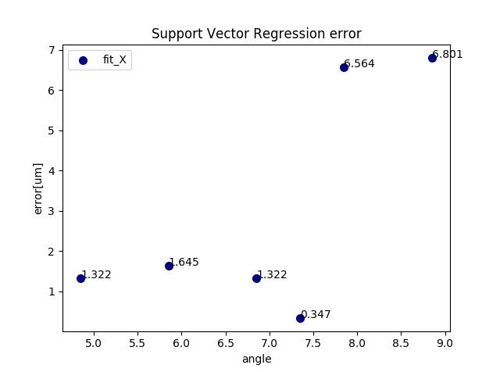
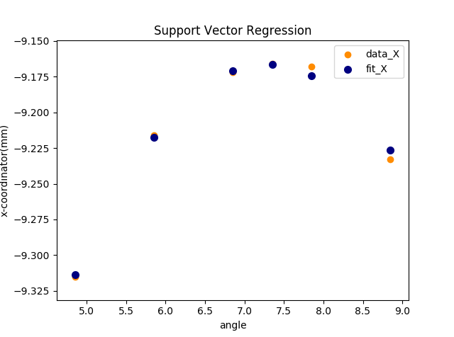
Training points set 0,1,2

Slide 4
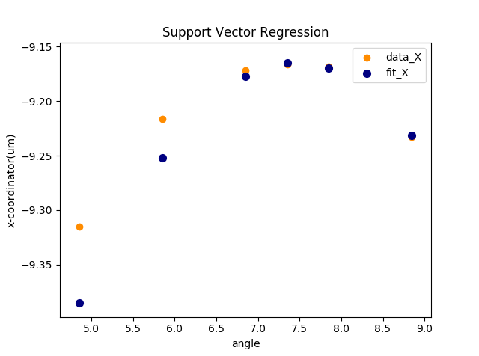
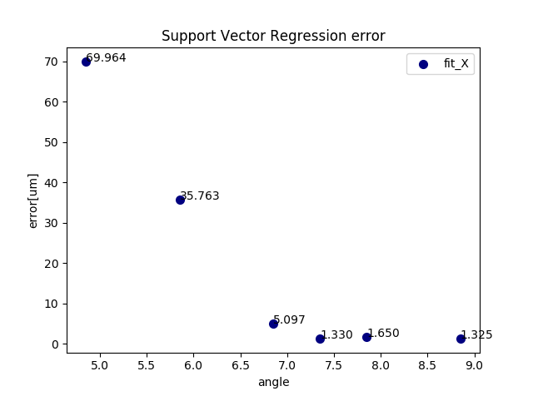
Training points set 3, 4, 5
When training model based on point 4, the error can be pretty high

Slide 5
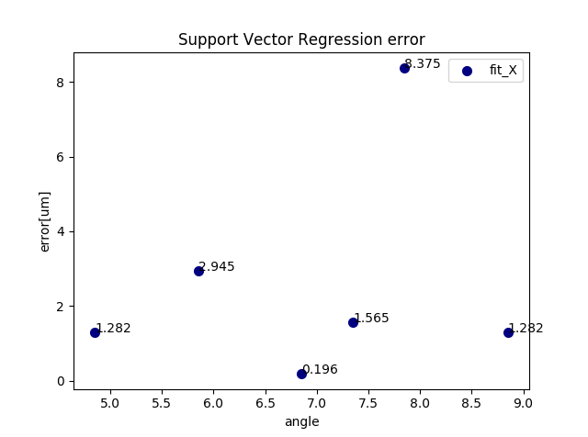
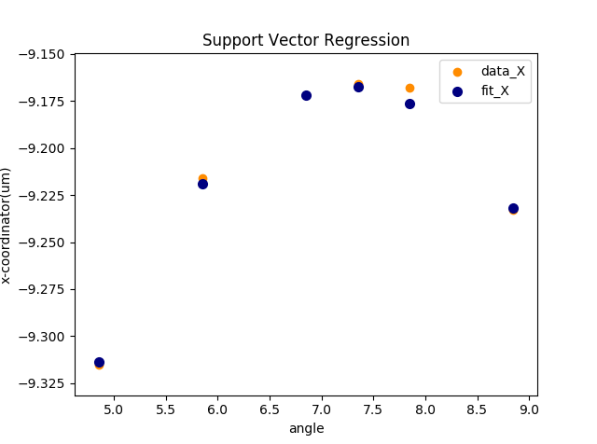
Training points set 0,3,5
When training model based on point 0,1,2, the error of point 4 is still higher but others maintain good.

Slide 6
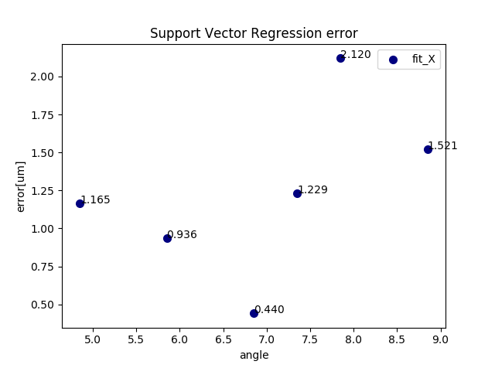
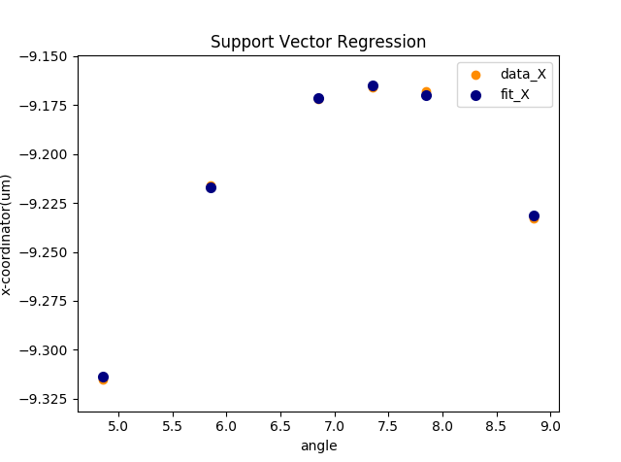
Training points set ALL POINTS

